Slide 1
Adapting Lessons
Yekaterina Milvidskaia and Tiana Tebelman
CSUSM March 12, 2015

Slide 2
Background
8th grade math teachers at Vista Magnet Middle school (4th and 5th year)
Math for America San Diego Fellow and Alumni

Slide 3
Math Teaching Philosophy
We strive to give students open ended, rich math problems that allow students to think critically and lead them to discover or see the need for a mathematical concept.

Slide 4
In Our Classroom We Believe that
Students must be thinking to be learning
Less is more and deeper is better
Student collaboration is key
Student thinking and creativity should be highlighted
All students have mathematical abilities that should be valued
Mistakes are important

Slide 5
How to Adapt Lessons
Two of the fundamental components of adapting a lesson involve changing the:
Lesson Content
Classroom Culture

Slide 6
Lesson Content

Slide 7
CPM Problem CC Course 3 (8th)

Slide 8
Modified Problem
Small Modification:
Delete directions and don’t give students a numbered/labeled graph to use.
Further Modification:
Given the table, predict the cost of the vehicle with 23,000 miles.

Slide 9
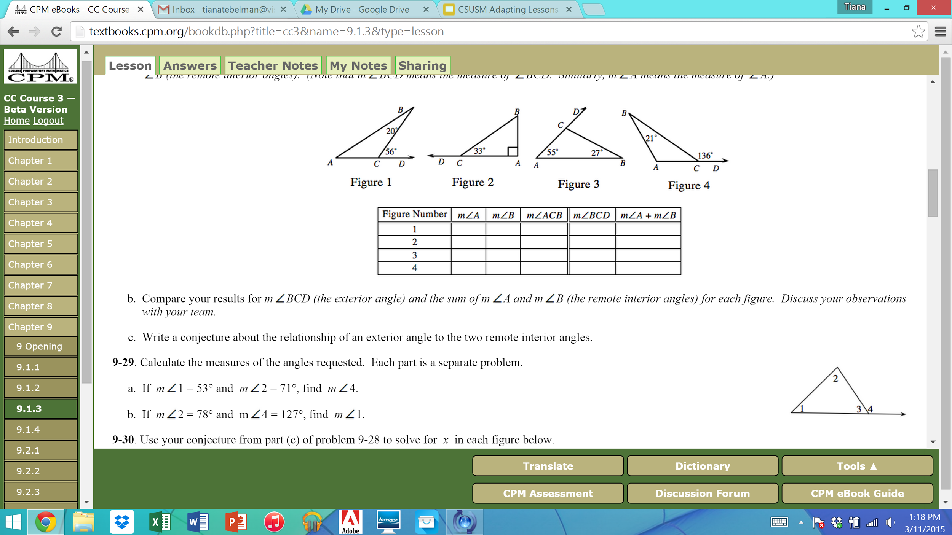
CPM Problem CC Course 3 (8th)

Slide 10
Modified Version
Is it possible to find the measure of angle 1 if angle 2 is 78º and angle 4 is 127º. Provide mathematical justification for your claim.

Slide 11
Compare and Contrast
What differences and similarities do you notice?
Which lesson would you prefer as a student?
Which mathematical practices standards are addressed in each lesson?

Slide 12
The Secret Weapon… when things fail...
The “student from last year” had this conjecture…
The “student from last period” had the idea to…
Do you agree or disagree with them?

Slide 13
Holt Textbook Algebra Problem
80. Carrie is reading a book and wants to find the first page of a specific chapter. She is now on page 217. She knows that the chapter she is looking for starts within 40 pages of where she is now. Write and solve an absolute-value equation to find maximum and minimum page numbers where Carrie should look. (Lesson 2-7)

Slide 14
Adapted Algebra Problem
Book Problem
Gabriel is reading a book and he is currently on page 105. He is looking for a specific event and he knows that the event is within 30 pages of the page he is currently on.
a)Which of the following page numbers are possible pages where he should look? Please circle them.
111, 125, 140, 177, 99, 86, 75, 74

Slide 15
Adapted Algebra Problem
Book Problem (continued)
b) What is the lowest possible page number that he should look at? What is the highest possible page number that he should look at?
c) What are ALL the possible page numbers where Gabriel might find the specific event? Please represent your solution in as many ways as possible.

Slide 16
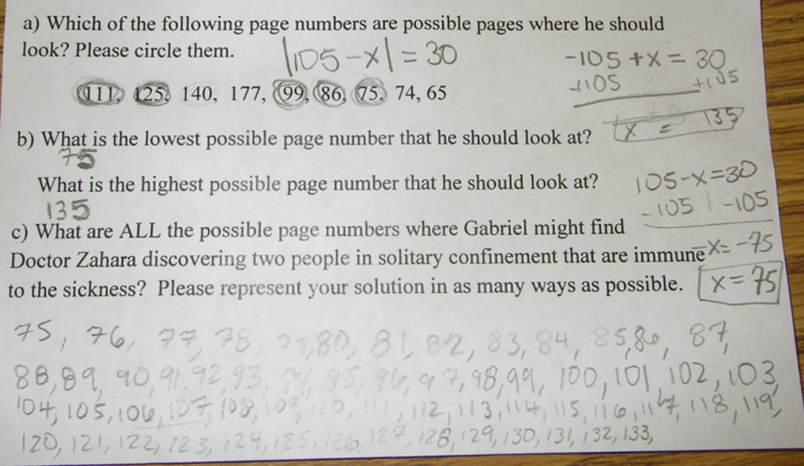

Slide 18
Traditional Transformation Problems

Slide 19
Modified Version
Directions: Your goal is to rotate the following
pre-image (triangle ABC) so that it matches
my new image exactly (triangle A'B'C'). First,
your team must decide which questions you
need to ask in order to rotate the pre-image
correctly. Your challenge is to ask as few
questions as possible. When your team has
written down your question(s), please have
the Team Captain raise their hand to ask the
question(s).

Slide 20
Why Modify?
•Increased student engagement
•Effective method of eliciting student thinking
•Students create their own mental images, instead of imposing teacher's image
•Students appreciate different methods and ways of thinking
•Students see a need for mathematics

Slide 21
Changing Lesson Content
Remember that less is more and deeper is better. Consider fewer problems for students to work on.
Leave problems open-ended and don’t tell students what tools to use to solve the problems. Let the students think and be creative.

Slide 22
Teacher Guide

Slide 23
Classroom Culture

Slide 24
Classroom Culture
Purposely structured group work(group roles, complex instruction, high expectations)
Student presentations to value multiple approaches, methods, and mistakes
Teacher is the facilitator and questioner

Slide 25
Change Takes Time… Start Small!
Don’t try to change everything at once!
Try implementing one idea at a time
(but keep a list of other things you want to try later so you don’t forget them)

Slide 26
Questions?

Slide 27
Work on Adapting a Lesson
Pick an upcoming lesson and think about ways to modify the lesson so that:
Students are puzzled
Student can be creative
By the end of the problem, students will see the need for the mathematics they learned.
Be ready to share your ideas!

