Slide 1
How to find the exact value of $csc θ$

Slide 2

To find the exact value of
$$csc θ$$
Draw a unit circle (pokeball)
Since CSC $θ$ is the inverse of SIN $θ$ we just need to solve the problem as if it were SIN $θ$
Based on the denominator of the angle measurement, we break the top half of the pokeball into that many parts.
Draw either the 30 60 90 or 45 45 90 triangle and label the sides
Since the problem is SIN, and we need to find CSC, just take the reciprocal of your answer.

Slide 3
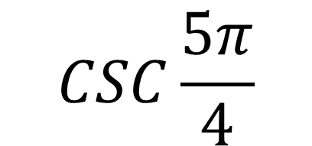
$$CSC\frac{5π}{4}$$
Draw a unit circle (pokeball)
Since CSC $θ$ is the inverse of SIN $θ$ we just need to solve the problem as if it were SIN $θ$
Based on the denominator of the angle measurement, we break the top half of the pokeball into 4 parts.
Draw the 45 45 90 triangle and label the sides
Since the problem is SIN, and we need to find CSC, just take the reciprocal of your answer.
-$\frac{√2}{2}$
$$−\frac{2}{√2}=−\frac{2}{√2}\frac{√2}{√2}=−\frac{2√2}{2}$$

Slide 4
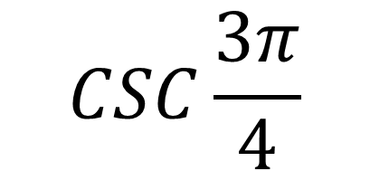
SOLVE
$$CSC\frac{3π}{4}$$

Slide 5
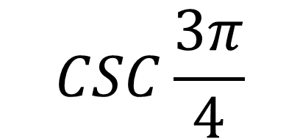
$$CSC\frac{3π}{4}$$
Draw a unit circle (pokeball)
Since CSC $θ$ is the inverse of SIN $θ$ we just need to solve the problem as if it were SIN $θ$
Based on the denominator of the angle measurement, we break the top half of the pokeball into 4 parts.
Draw the 45 45 90 triangle and label the sides
Since the problem is SIN, and we need to find CSC, just take the reciprocal of your answer.
$$\frac{√2}{2}$$
$$\frac{2}{√2}=\frac{2}{√2}\frac{√2}{√2}=\frac{2√2}{2}$$

