Slide 1
Statistics in Int 3/Alg2: Be Random and Normal…with Margin for Error
Renee Kollar-Bachman
reneekollar@vistausd.org
Tina Shinsato
tinashinsato@vistausd.org

Slide 2
About Us
Renee
Tina
Teaching for over 19 years
Currently Integrated 1, AP Stats, Dance
Math Department Chair
Choreographs musicals
Teaching for over 23 years
Currently Integrated 1, AP Stats
MS and HS coaching experience
Mountain Biker

Slide 3
Content Standards
S-ID-4: Use the mean and standard deviation of a data set to fit it to a normal distribution and to estimate population percentages. Recognize that there are data sets for which such a procedure is not appropriate. Use calculators, spreadsheets, and tables to estimate areas under the normal curve.
S-IC-1: Understand statistics as a process for making inferences about population parameters based on a random sample from that population.
S-IC-3: Recognize the purposes of and differences among sample surveys, experiments, and observational studies; explain how randomization relates to each.
S-IC-4: Use data from a sample survey to estimate a population mean or proportion; develop a margin of error through the use of simulation models for random sampling.

Slide 4
In other words…
S-ID-4: Estimate percentages with Normal Curves
S-IC-1/4: Take a random sample and estimate a parameter
S-IC-3: Understand the role of randomization in taking samples and doing experiments
S-IC-4: Develop a margin of error through the use of simulation models for random sampling.

Slide 5
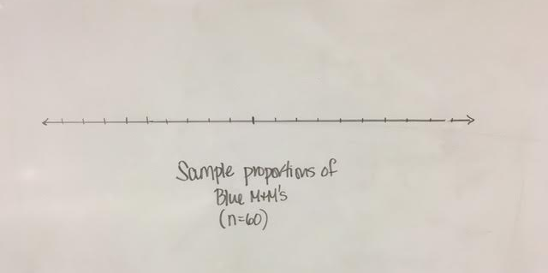

Slide 6
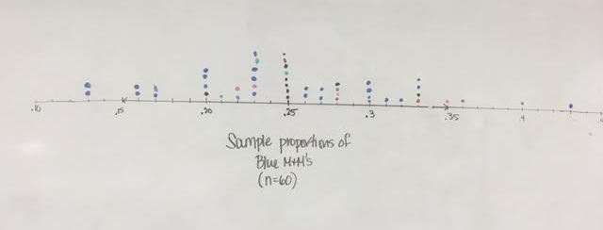

Slide 7
Send your text message to this Phone Number:
37607
poll code
for this session
Speaker was engaging and an effective presenter (0-3)
Other comments, suggestions, or feedback (words)
___ ___ ___ ___________
580648
(1 space)
(1 space)
(no spaces)
Speaker was well-prepared and knowledgeable (0-3)
Session matched title and description in program book (0-3)
Example: 580648 333 Inspiring, good content

Slide 8
Statistics in Int 3: Be Random and Normal…with Margin for Error
Renee Kollar-Bachman Tina Shinsato
reneekollar@vistausd.org
http://rbvmathshinsato.weebly.com/ tinashinsato@vistausd.org

Slide 9
Renee Kollar-Bachman
reneekollar@vistausd.org
Tina Shinsato
tinashinsato@vistausd.org
http://rbvmathshinsato.weebly.com/

